Slide 1

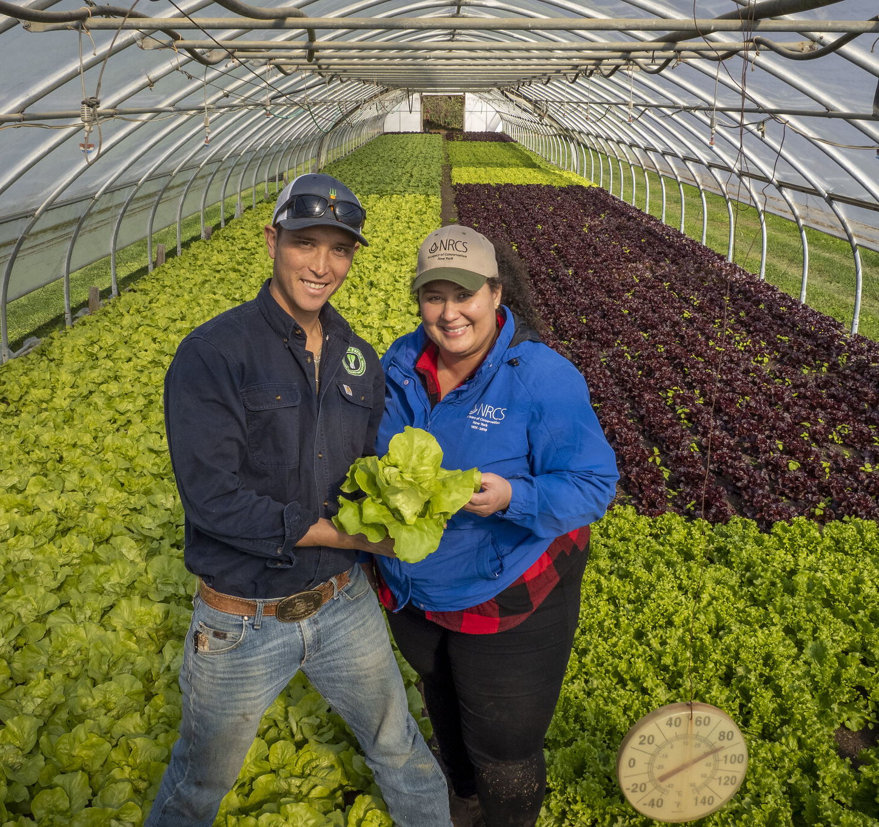
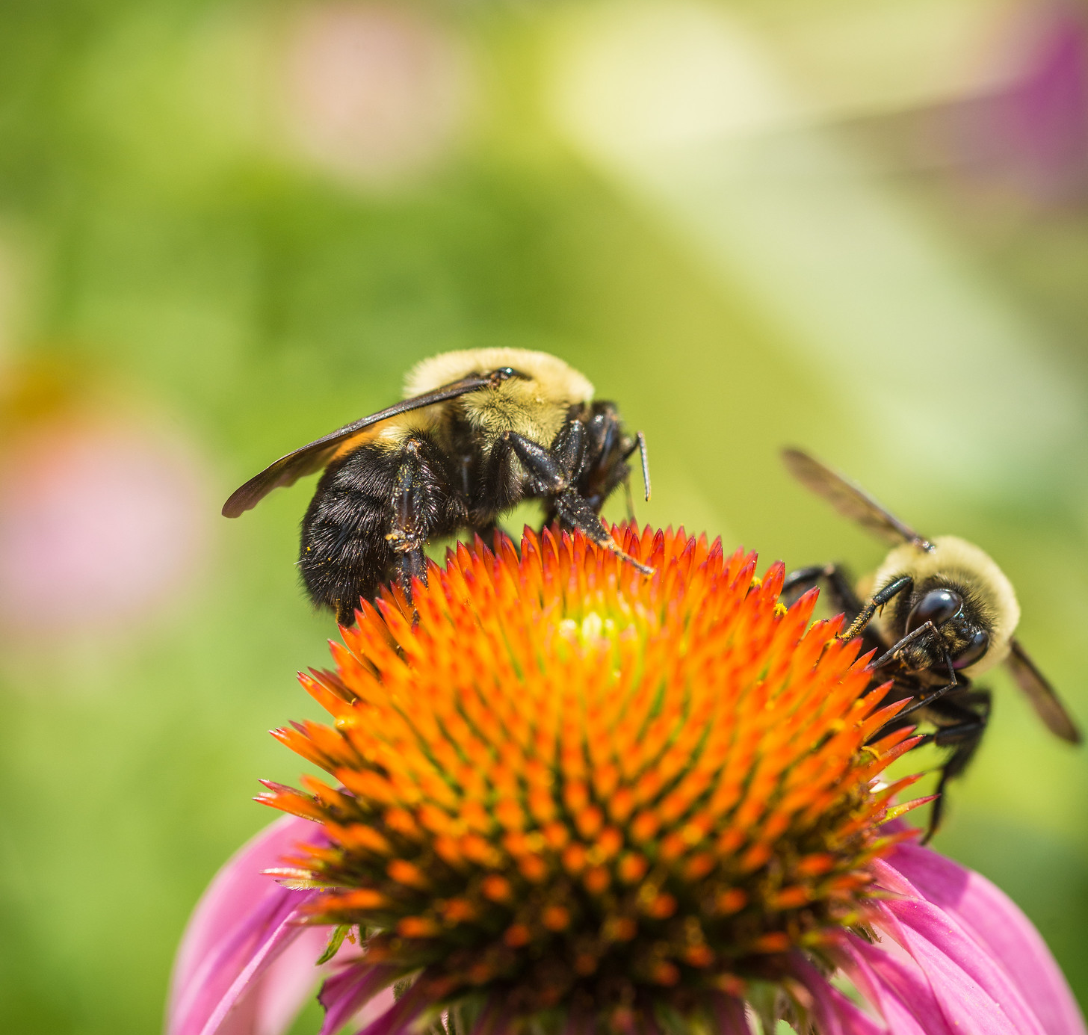

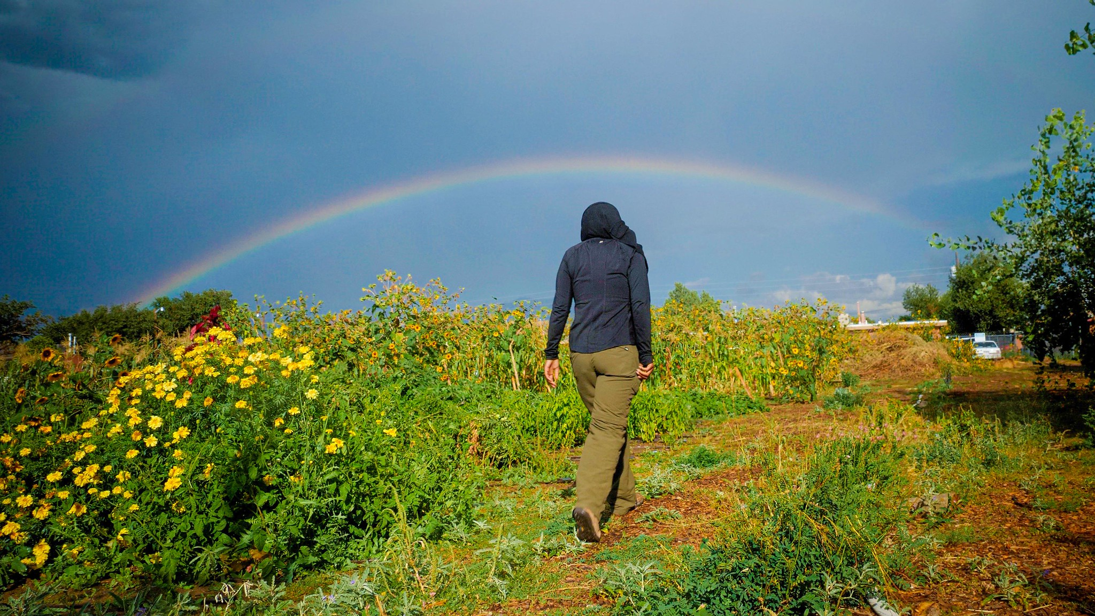
Soil Health for Small-Scale Agriculture
Introductions – Location, Date
Notes:
This Powerpoint file can be used to organize the “Participant Introduction” activity at the start of the first day of the training.

Slide 2

WELCOME AND INTRODUCTIONS
In 1-2 minutes: name, where you are from, and what does soil health on urban and small-scale farms look like to you?
Notes:
The goal of this activity is to have participants submit one powerpoint slide about themselves to a Sharepoint folder before the training (We recommend requesting that all submissions be made by one week out from the training). Participants will need to download a copy of the slide template, insert their information and photo, and then re-submit to sharepoint. This is very important. If they simply edit the file that they find in Sharepoint, it is possible that they will end up deleting someone else’s work and there will not be slides for each person.
The slides should contain the following: person’s name, their duty location or home state, and a photo that they feel addresses the question “What does soil health on small-scale or urban farms look like to you?”
They also need to be prepared to introduce themselves and the image that they submitted during the Introduction activity. In order to keep the agenda on track, each participant will only have a short time to present their information and the activity should have a designated timekeeper. In large trainings where we had 30+ participants and handful of instructors, we gave each person one minute to introduce themselves and dedicated one hour for the activity on the agenda. For smaller groups, two minutes may be appropriate. The key points are that everyone gets the same amount of time (instructors should model this) and one person is a time keeper who runs a timer for each person in the group. We have had really nice results using this activity in our pilot training.

Slide 3
Name: Insert your name here
State: Insert the state you work in here
Insert your small-scale soil health photo here.
Notes:
Blank slide to use for introduction. This can be used as a template site – either in a sharepoint folder or emailed to everyone in the class ahead of time.

Slide 4
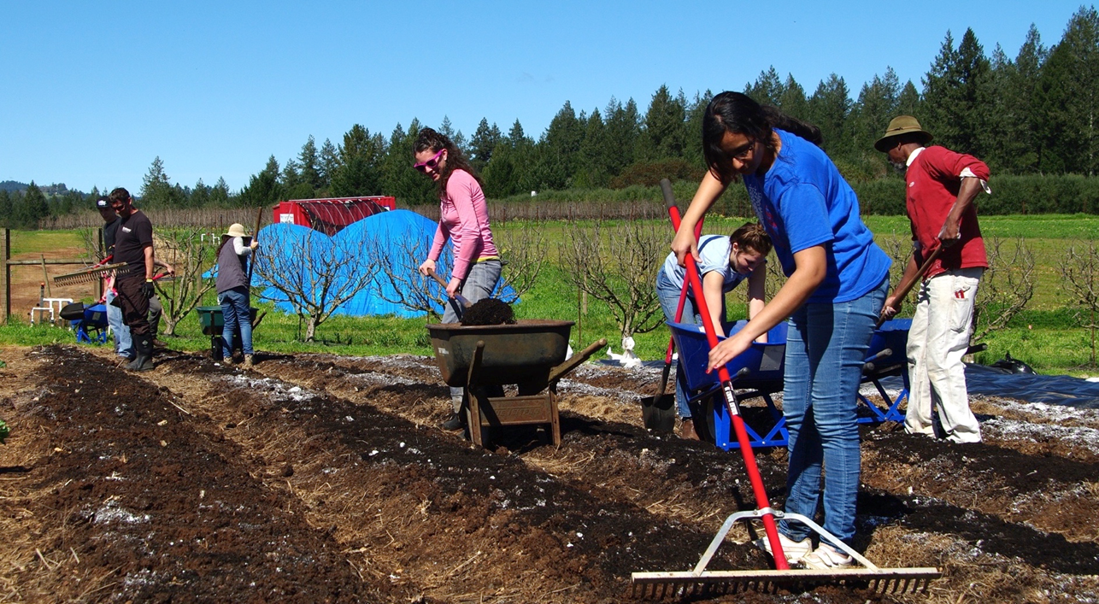
Hi, my name is: Josh Beniston
I work in this State: California
Notes:
The next three slides are examples that were submitted by staff from the NRCS Soil Health Division for the initial pilot training of this class in 2024.

Slide 5
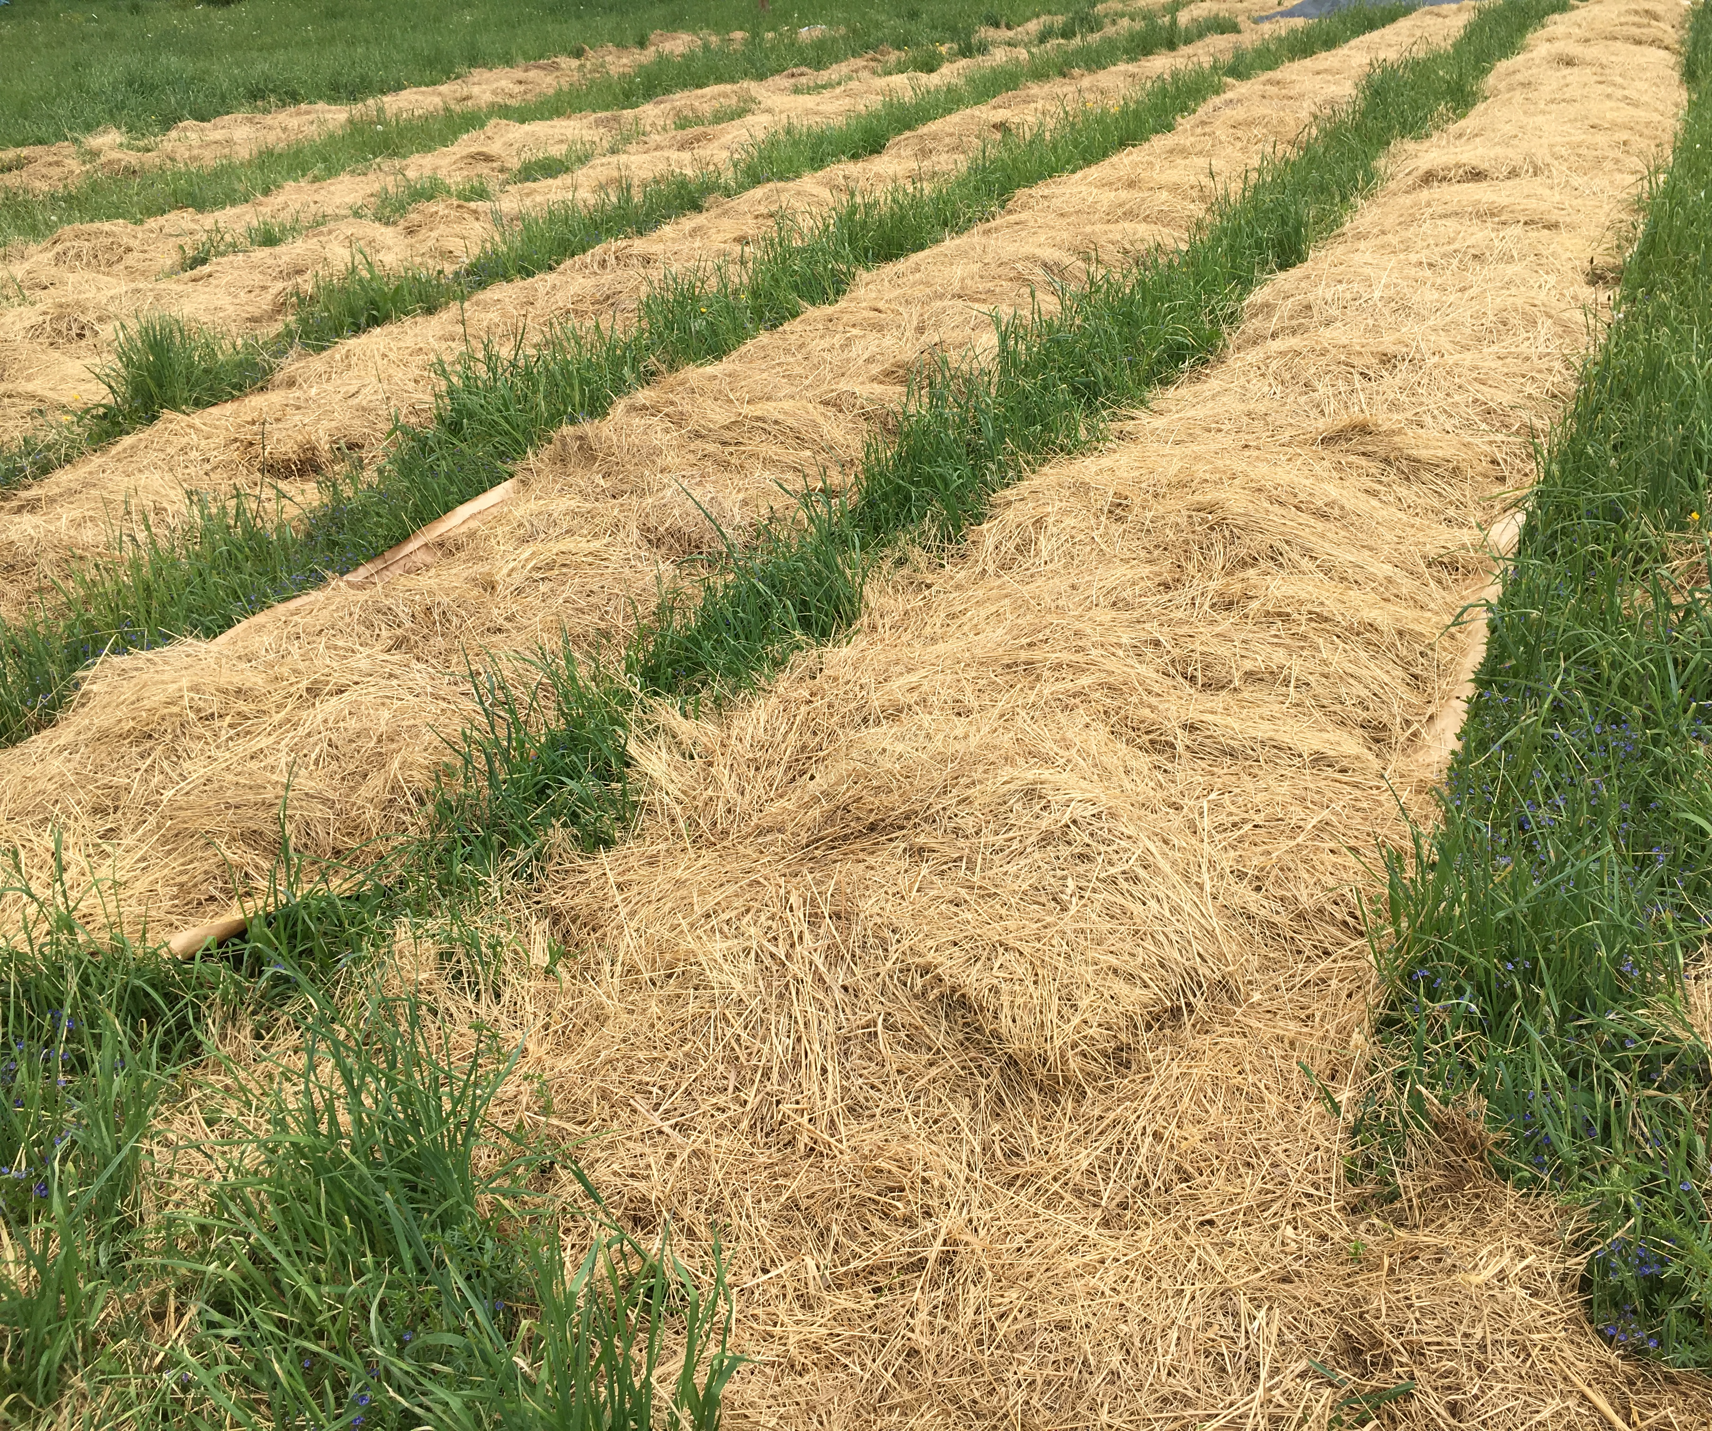
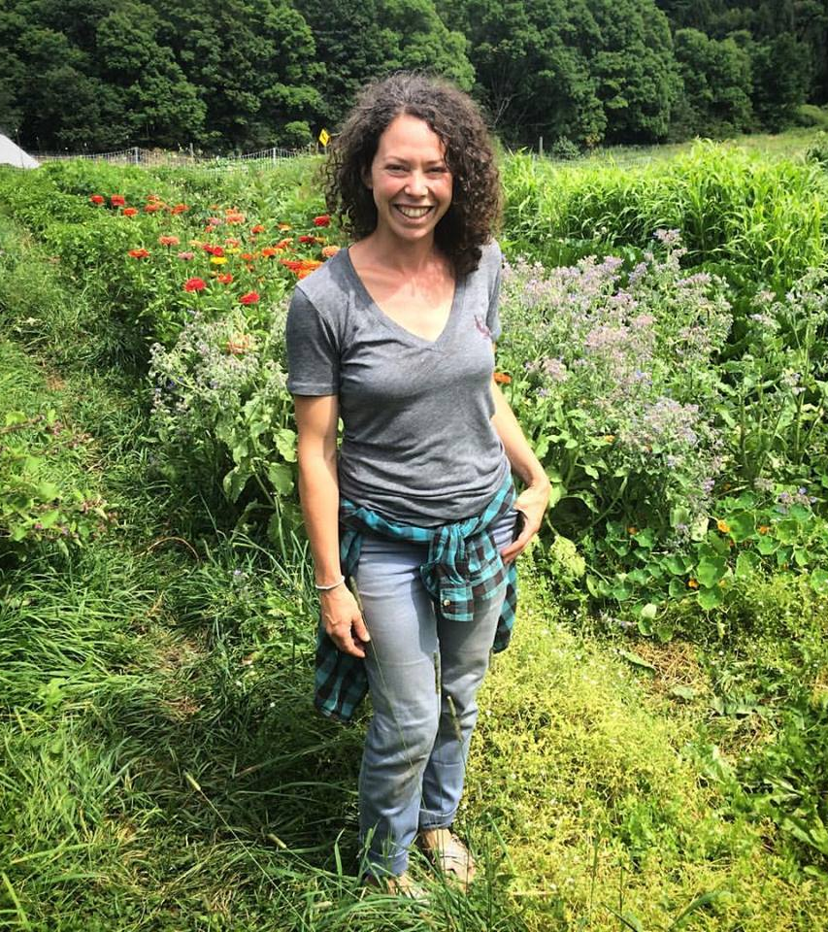
Elizabeth Marks –
New York

Slide 6
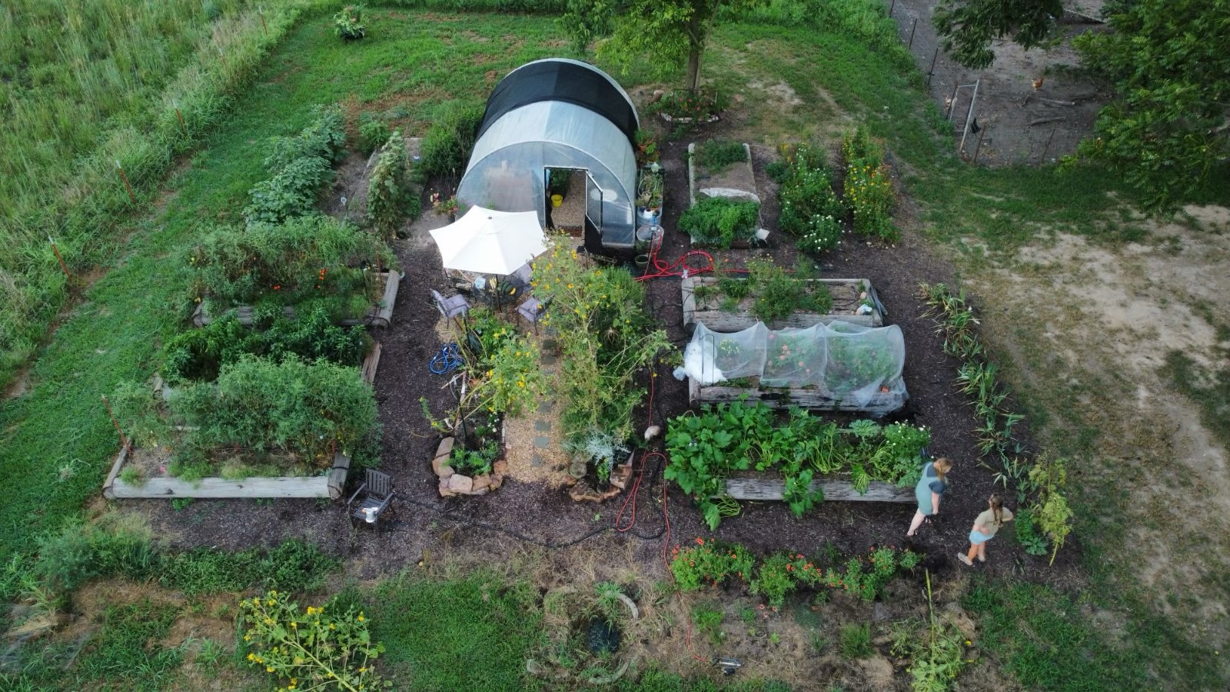
Drexel Atkisson
I live in Missouri

